Slide 1
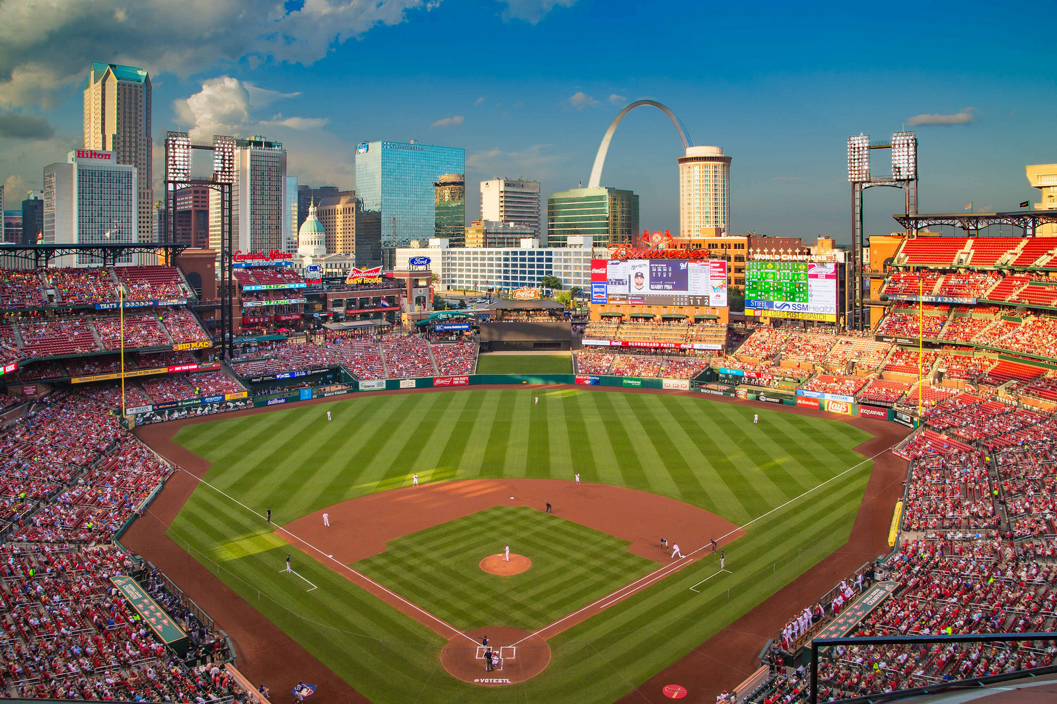


BATTER UP
RISING TO THE OCCASION OF
MOBILE/WEB OPTIMIZATION
Team Kakarot
University of Texas at Dallas
Adobe Analytics Challenge 2019

Slide 2



ROSTER
YI-YING LIN
VIKRANT DEV RATHORE
CAROLINE SPARKS
MS Business Analytics, UT Dallas
LinkedIn: /yi-ying-lin
MS Business Analytics, UT Dallas
LinkedIn: /vikrant31
MS Marketing, UT Dallas
LinkedIn: /carolinefsparks

Slide 3
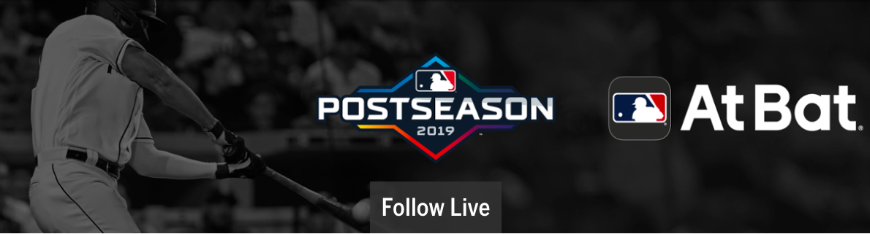
THE FIRST INNING
Did you know?
According to Forbes, the average Major League Baseball team is worth $1.78 billion¹
The average Major League Baseball ticket costs $32.99 as of July, 2019²
In 2018, total attentdance for Major League Baseball regular season games was 69.65 million people³
65% of GenZ and Young Millenials are consuming sports content on a mobile device⁴
Why does this matter?

Slide 4
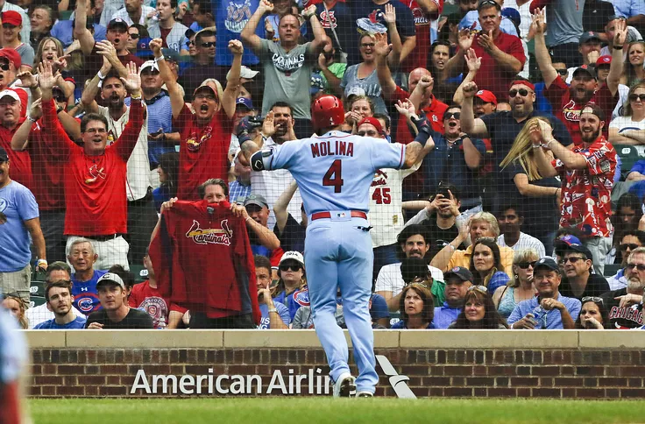
HOW CAN MLB BRING A BELOVED IN-STADIUM EXPERIENCE, AND CREATE THE SAME EXCITEMENT
AND PERSONALIZED TOUCH ONLINE?
Notes:
The time frame of data is we are analyzing is from January 2019 to 8th October 2019.
>> Introduce something about MLB and revenue and adobe analytics

Slide 5
Visits - used for finding traffic on site
01
Unique Visitors - how many different users visit the site
02
Page Views - how many times was a particular page viewed?
03
Revenue - what was the revenue and what drove it?
KEY METRICS FOR MLB
04
.
Conversion Rate (Orders/Visits) –
how many orders are placed per visit?
05
Revenue per Visit, RPV - what is the revenue earned per visit?
06
Revenue per Visitors –
what is the revenue earned per unique visitor?
07
Revenue per Order - what was the average order value? (AOV)
08
Notes:
Simply explain why we put this point as our KPI

Slide 6
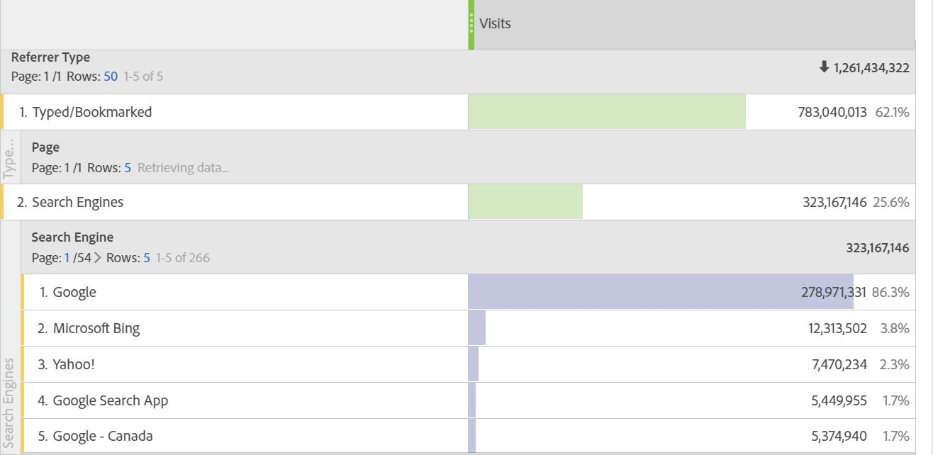
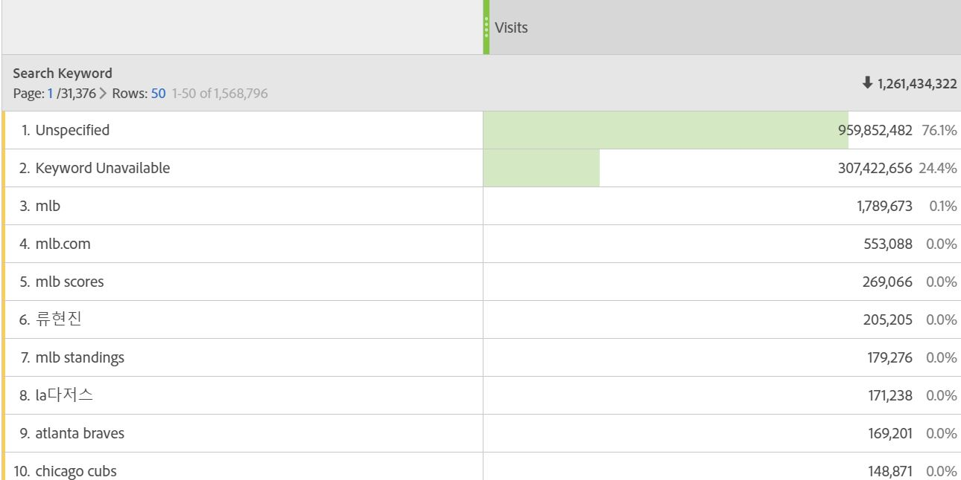
HOW ARE FANS COMING TO THE SITE AND APPS?
Figure 1: Illustrates how users are getting to the MLB website.
Figure 2: Popular keywords searched to reach the MLB website.
Notes:
From the left freeform table, we observe that most visitors come through bookmarks/direct load at the MLB site. Google.com is the most popular traffic driving source to the MLB site after direct load. The right freeform table shows the popular keywords searched on search engines to reach the MLB site.

Slide 7
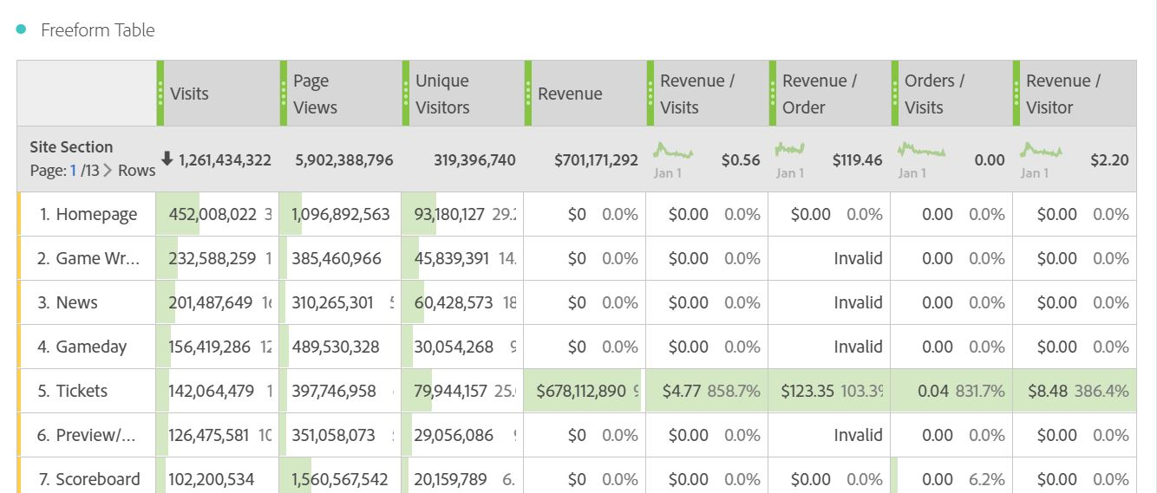
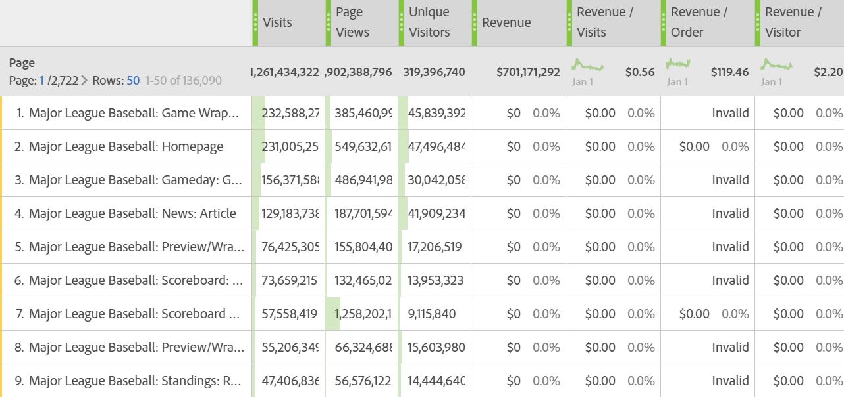
WHAT DO VISITORS DO WHEN ON THE SITE?
Figures 3 & 4: Demonstrates the pages people are visiting on the site.
Notes:
From the freeform tables for for page sections and pages we can clearly see what sections and pages do visitors come to see at the MLB site.
1. After direct load and natural search, the most visits came from google.com , so google is the best marketing channel for MLB and the most searched keyword on google was ‘mlb’.
2. MLB had close to 320 million unique visitors on their website, however we have to keep in mind that Unique visitors does not necessarily mean they were unique customers/ people.
3. The most viewed site section is Homepage section with over 1 billion views and within that section the most popular page was Major league baseball: homepage
4. The site section of ticket generate the most revenue which was around 679 million dollars follow by MLB TV and other services which generate 22 million dollars combine
5. The ticket section had a conversion rate of 0.04%, it looks very low, but it is probabily because of there are a lot of people visit ticket section but either don’t end up placing order or they might place after number of visits
6. Every visit on the ticket section MLB makes average of 4.77 dollars, however when we include the MLB.TV services as well, the revenue per visit is about 56 cents.
7. For every unique visitor on the ticket section MLB makes average of 8.48 dollars, however when we include the MLB.TV services as well, the revenue per visitor is about 2.2 dollars.
8. Each order brought the average of roughly 123 dollars on the ticket section and if we include the MLB TV services the total AOV is around 119 dollars

Slide 8
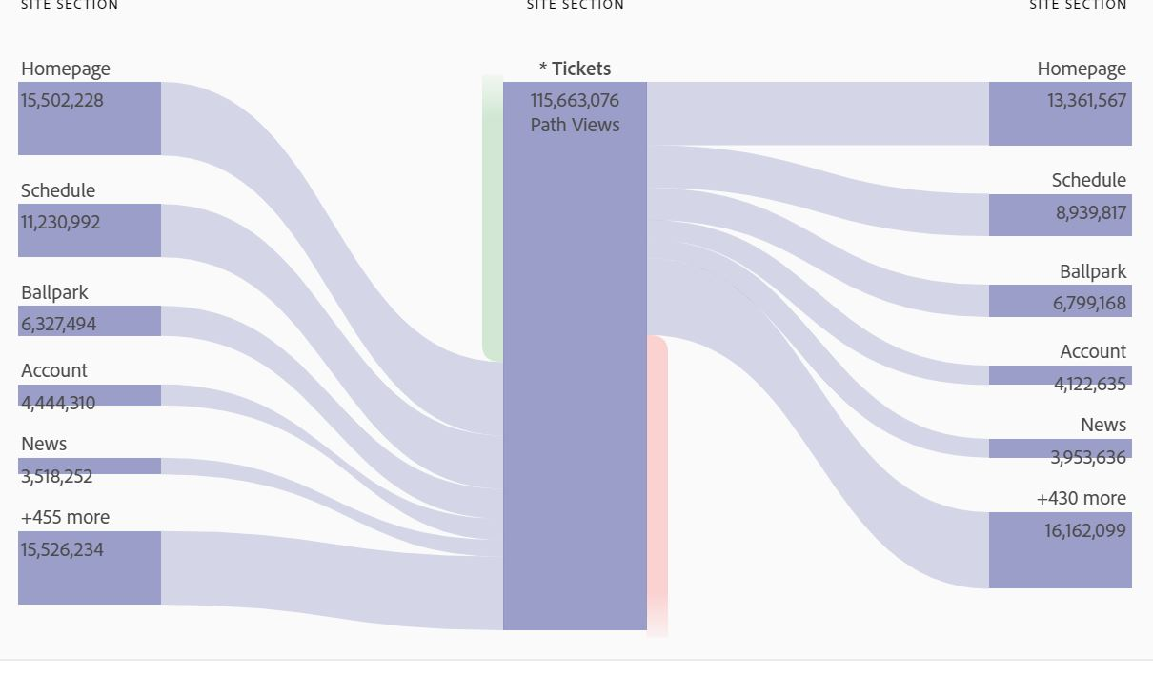
HOW DO VISITORS REACH THE PURCHASE PAGES?
Figure 5: How customers are reaching the ticket section on the MLB site.
Notes:
The flow visualization for the tickets section gives a clear view that how customers are reaching the ticket site section of MLB
We chose ticket section because it drive most revenue for MLB online
In this page we would like to know, how to visitor reach purchase page and how they navigate after that

Slide 9
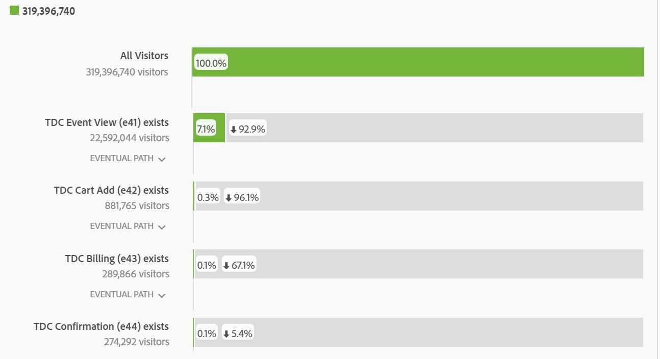
PURCHASE FALLOUT
Figure 6: Where is MLB losing customers during the purchase process?
Notes:
So visitors here represent the unique visitors that visited MLB.
We see that there were some 300 million visitors on MLB out of which 7.1% or 22 million reached the purchasing section( here event view means that) which is expected as not all visitors coming to the MLB website will be interested in purchasing a ticket some of them might just want to see scores, schedules or other news related to MLB.
So from viewing tickets, approximately we had a fallout of 96.1% or from 22 million we had only 890,000 visitors adding tickets in their cart.
Then further we had a fallout of 67.1% customers from cart additions to billing, so MLB needs to improve in the cart additions and billing area as we see the maximum number of people dropping out of the ticketing systems in these areas.
The fallout from billing to confirmation is not very significant as out of 290,000 visitors some 274,292 visitors made purchases.

Slide 10
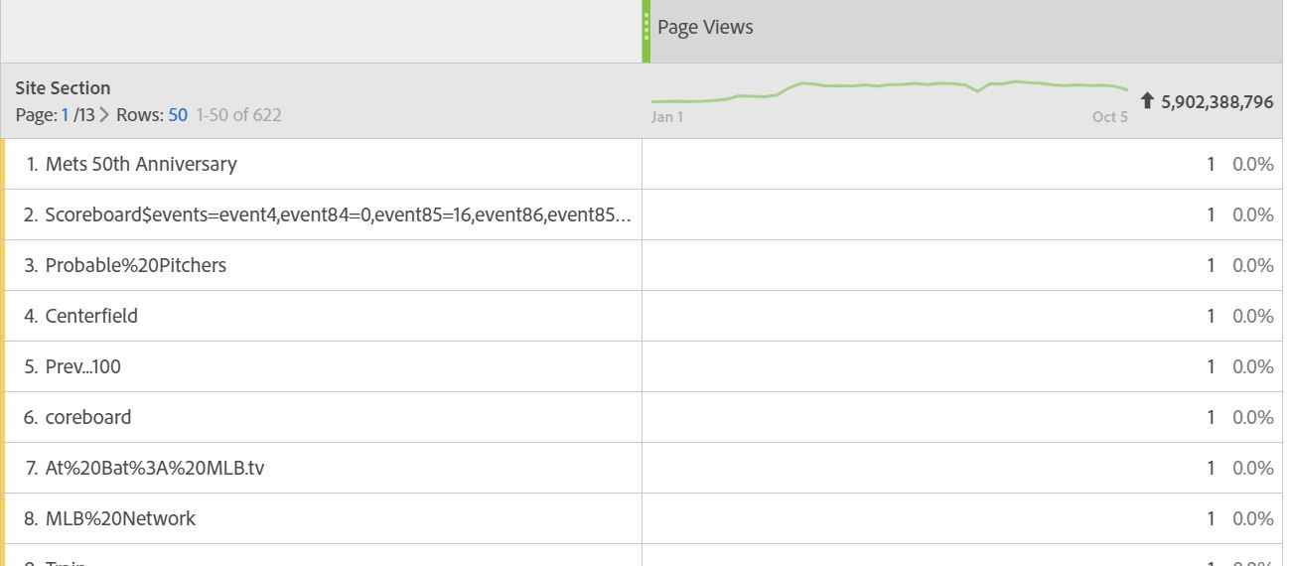
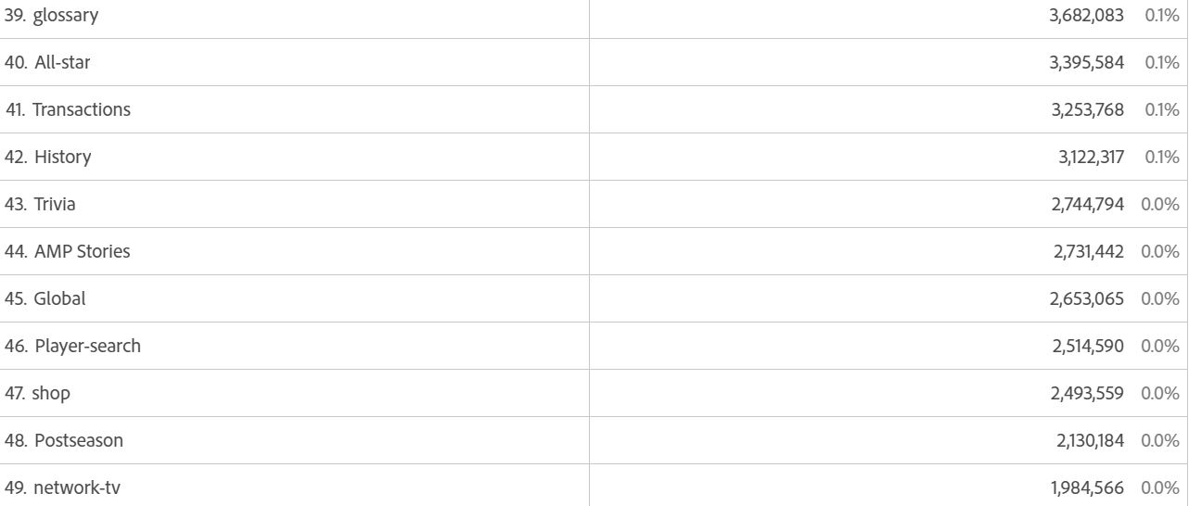
WHICH WEBSITE/APP SECTIONS ARE HARD FOR USERS TO FIND?
Figures 7 & 8: Illustrates site sections with a low number of page views.
Notes:
Based on page views , we see that some site sections only had 1 page view and most likely these seem like unimportant pages. However, one interesting find is that the MLB network TV section had some 2 million views from January 2019 to October 5 which is quite low considering the total page view for all MLB site sections!

Slide 11
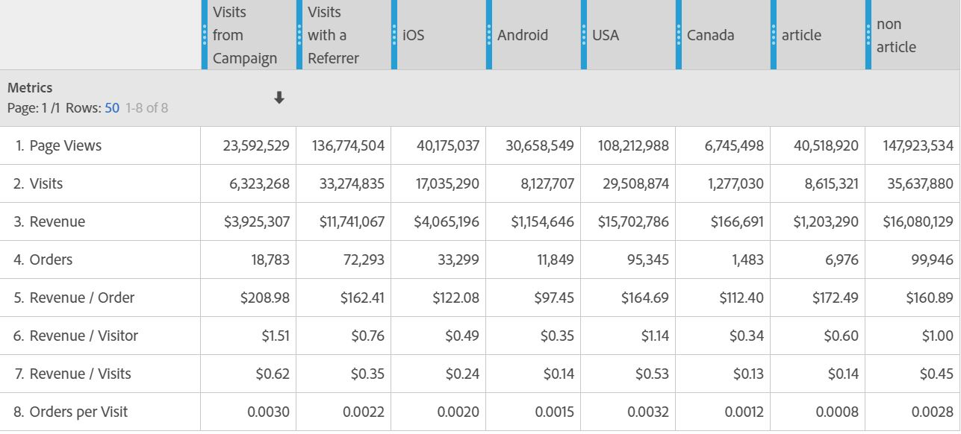
DIFFERENCES IN USER COHORTS
Figure 9: Important KPI differences amongst cohorts.
Notes:
Comparing visits from campaign and from referrer we see that the campaigns had a good impact on important KPI’s like Conversion rate, Revenue per visits and per visitor to name a few. Similarly iOS was the more popular OS and more iOS users made purchases at MLB.
Why we want to choose Canada
The second popular country to follow MLB
Some part of MLB team is from Canada

Slide 12
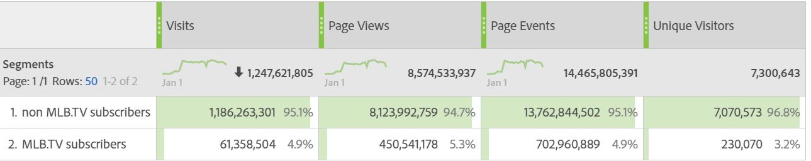
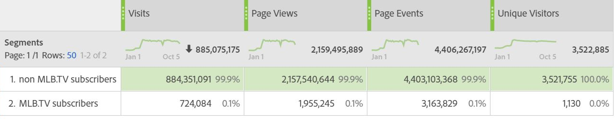
DIFFERENCES IN USER COHORTS
iOS
Android
Figures 10 & 11: Important KPI differences amongst cohorts.
Notes:
The top freeform table represents how non MLB.TV subscribers differ from MLB subscribers in the iOS version of the app, while the bottom one represents the same for android.
From the freeform table above we see that android has very little users as MLB subscribers with ratio of MLB subscribers to non MLB subscribers as 0.0003 whereas in Ios the same ratio was 0.04. The android users need to be targeted better.
We suggest that MLB evaluate what is happening in android as the number of android subscribers for MLB.TV is very low and from the ratio we can see that there is a better chance to target android customers as we have more than 3 million non subscribers for android.
We have more than 7 million customers that are not subscribers, which MLB can target better.
The caution to this evaluation is that maybe some of the non subscribers are already having channels on their TV where the can view MLB games.
https://plus.espn.com/mlb ESPN+ (ALSO HAVE MLB.TV)

Slide 13



HOW ARE CUSTOMERS BEING UNDERSERVED?
It is difficult to reach the tickets page while navigating through the MLB site and can been seen from the fallout for purchases which can be attributed to the fact that MLB groups a lot of other events as well with the tickets page.
After going through the Internal Search Terms for MLB in Adobe Analytics, it was observed that only players names were found in it which can be attributed to the fact that MLB does not have a General Search on its website.
According to the page views, the network tv received less views which could mean that customers are having a hard time reaching it.
Notes:
So what MLB does is during the purchase of tickets, a lot of other events like music concerts etc are having their tickets sold on the MLB site which may make it a little difficult for a customer who is just interested in purchasing MLB tickets.
The second part, we can compare other website
https://www.premierleague.com/
https://www.mlssoccer.com/search/FC%20DALLAS
So it is suggested that the network tv page is made more aceesible to users through marketing or campaigns.

Slide 14
BOTTOM OF THE 9TH
For mobile, it would be wise to do one of two things (or both):
Aim your primary focus to Apple users, as iOS returns significantly more revenue
Increase marketing for Android users, in order to hopefully increase revenue.
Majority of MLB site users are reaching the Tickets page from the homepage, with Schedule coming in second place
Make the network tv page more accessible to customers.
Most fans are coming to the MLB site via site bookmarks - keep up this customer and team loyalty
Put a general search bar on the homepage so that it is easier for customers to find what they are looking for.
Notes:
summary

Slide 15
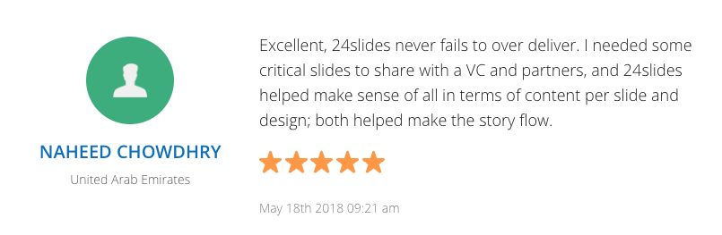
SOURCES / WORKS CITED
https://www.axios.com/major-league-baseball-team-value-a8454505-cc7d-4bb3-9406-d4f11cce7f80.html
https://www.statista.com/statistics/193426/average-ticket-price-in-the-mlb-since-2006/
https://www.statista.com/statistics/193421/regular-season-attendance-in-the-mlb-since-2006/
https://www.prnewswire.com/news-releases/usc-annenbergthepostgame-genz-and-younger-millennial-sports-fans-are-driving-fundamental-changes-in-programming-platforms-and-purchasing-300271545.html

Slide 16
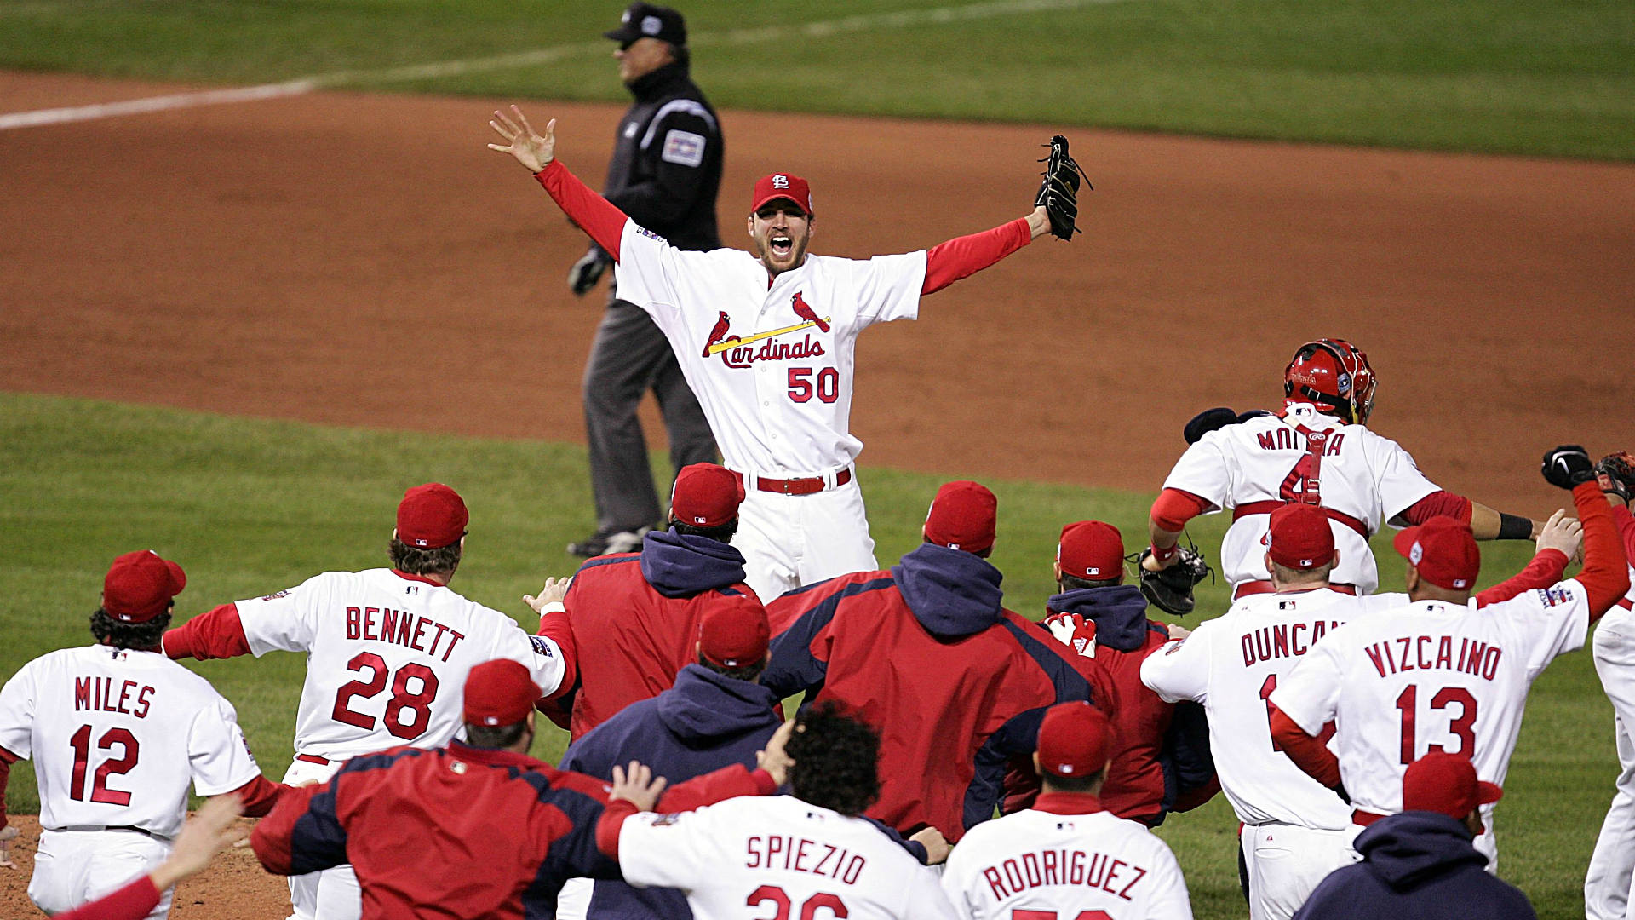
THANK YOU

